Slide 1
Mouhamed El Bachir El Ibrahimi University
-Bordj Bou Arreridj-
The Second Virtual National Forum on:
The role of local authorities in achieving local development in the shadow areas in Algeria
Intervention title: The role of local authorities in achieving local development in the shadow areas in Algeria
-A case study of the municipality of Bordj Zemoura during the period (2015-2020)-
دور الجماعات المحلية في تحقيق التنمية المحلية في مناطق الظل في الجزائر
-دراسة حالة بلدية برج زمورة خلال الفترة الممتدة بين (2015-2020)-
Prepared by:
Asma Righi
Hiba mezeaache

Slide 2
Introduction
Algeria has paid great attention to local development as it is the basic basis for any comprehensive development and the ideal tool for achieving a balanced development for all regions of the country. However, this matter requires the participation of many representatives' efforts at the local level, such as civil society, the Algerian government, and local authorities whose objectives are inspired by the basic needs of citizens.
Considering that the local authorities (the municipality and the Wilaya) are the central cells and the partners of the central authority in achieving local development, they have worked hard since their establishment to provide the requirements of their local community, but they have not reached their desired goal yet.

Slide 3
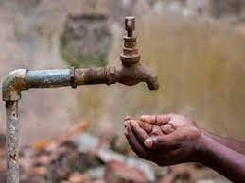
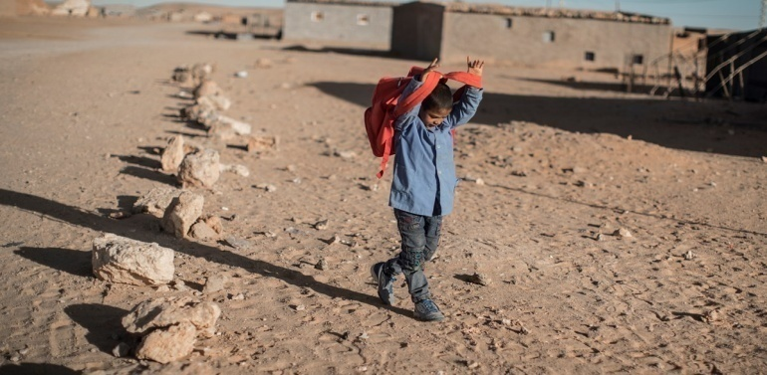
Lack of water
Lack of gas
Lack of job opportunities
Lack of schools

Slide 4
Shadow areas

Slide 6
RESEARCH problem
To what extent does Bordj Zemoura municipality contribute in achieving local development?

Slide 7
Sub-questions:
What is the contribution of the municipality of Bordj Zemoura in achieving the social dimension of local development?
To what extent does the municipality of Bordj Zemoura contribute in achieving the economic dimension of local development?
What are the most important obstacles which face the municipality of Bordj Zemoura during its performance of the development process?
Hypotheses:
The municipality of Bordj Zemoura contributes in providing all the basic and luxury social requirements of the local community;
The municipality of Bordj Zemoura never supports the economic units located in the area or in any field in the economic sector;
The municipality faces a number of obstacles, such as the absence of qualified manpower, the lack of institutions that implement projects, etc.

Slide 8
An analytical study of the role of Bordj Zemoura municipality in achieving local development

Slide 9
Table n (01): shows financial allocation spent by Bordj Zemoura municipality in social sector 2015-2020
Social activities | 2015 | 2016 | 2017 | 2018 | 2019 | 2020
Employment | 74040702 | 65587591 | 59931191 | 62084790 | 64049578 | 59123691
Maintenance | 37434964 | 42722970 | 34859642 | 3977341 | 32360595 | 32111466
Contribution in education charges | 553636 | 519540 | 0 | 897875 | 317010 | 346330
Social services in schools | 2565900 | 2362260 | 10857889 | 12666580 | 14077885 | 5409739
Direct social assistance | 7674682 | 2448266 | 2855250 | 124000 | 2952000 | 4426758
Public social hygiene | 1557403 | 1166000 | 0 | 2139000 | 572937 | 321300
School sports and cultural equipments | 151060 | 0 | 19023288 | 10569633 | 22028913 | 31206994
Health, social equipments | 0 | 0 | 0 | 0 | 0 | 0
Housing and construction | 20648843 | 2356263 | 7515648 | 6647340 | 11488260 | 16327990
Total | 144627190 | 117162890 | 135042908 | 99106559 | 147847178 | 149274268

Slide 10
Table n (02): shows financial allocation spent by bordj zemoura municipality in economic sector 2015-2020
Economic and cultural activities | 2015 | 2016 | 2017 | 2018 | 2019 | 2020
Economic development | 0 | 0 | 0 | 0 | 0 | 0
Distribution and transport | 0 | 0 | 0 | 0 | 0 | 0
Industrial, handicraft, and tourism equipment | 0 | 0 | 0 | 0 | 0 | 0
Industrial and commercial servises | 0 | 999940 | 0 | 0 | 0 | 0
Total |  | 999940 | 0 | 0 | 0 | 0

Slide 11
Table n (03): shows financial allocation spent by bordj zemoura municipality in infrastructure and network sector 2015-2020
Activties | 2015 | 2016 | 2017 | 2018
Road | 51824772 | 19813189 | 44026968 | 31040079
Network | 18676189 | 0 | 0 | 37326361
Total | 70500961 | 19813189 | 44026968 | 68366440

Slide 12
Obstacles facing the municipality of Bordj Zemoura in achieving local development:
The decrease in the budget revenues of the municipality;
The lack of flexibility in work;
The lack of local development requirements (availability of infrastructure, qualified labor, etc.);
The lack of complete interest in the economic sector would be among the most important sources of funding.

Slide 13
Results:
The municipality contribution to local development is very modest in the social and economic fields, as the municipality aims in providing the basic and necessary needs for the region;
The role of the municipality remains weak and very limited in achieving social development, and it is still far from providing a decent life for citizens;
The municipality does not contribute at all in achieving economic development in all its agricultural, industrial, commercial, and tourism sectors, although it is a tourist area par excellence;
The municipality faces many obstacles while carrying out the development process, such as low income, the lack of flexibility in work, the absence of the most important requirements for local development, etc

Slide 14
Recommendations
Resorting to Islamic finance to solve the problem of the lack of funding;
Paying more attention to the economic sector;
The necessity of the government’s intervention to help these areas as soon as possible until they will able to be self-reliant in running their affairs and having a kind of independence;
Carrying out the development planning process in line with the specificities of the region.

